Slide 1
Coordination Chemistry
Complexation Reactions

Slide 2
Another Bond Type
Coordination bonds are much more like an association
Predominantly occur with metal ions as a central atom being bound or “coordinated” with other ions or molecules
The ions or molecules that are bound to the central metal atom are called Ligands
This metal and ligand group is a Complex

Slide 3
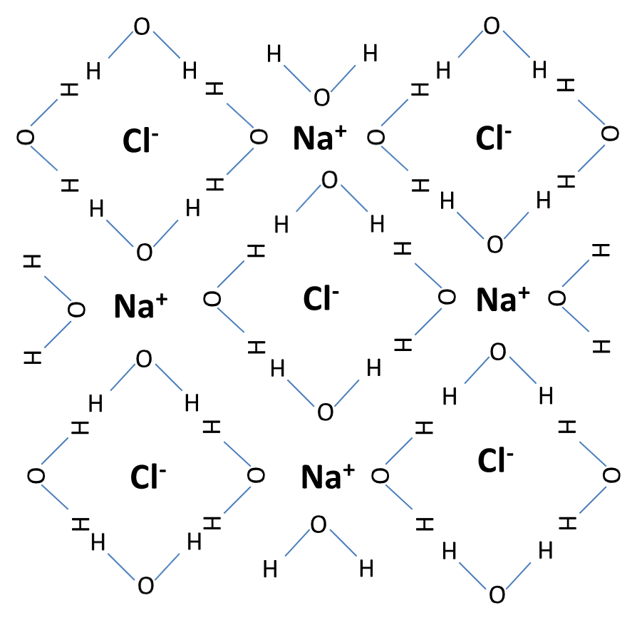
Hydration Shells
In the lecture course, hydration shells were talked about, as to how water will dissolve salts into their different ions

Slide 4
Hydration Shells
The water molecules surround the cations and anions
The shape of water allows for the negative oxygen atom to be towards the positive cation, while the positive hydrogens are arranged towards the negative anion

Slide 5
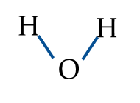
Aquocomplex
This cation surrounded by the water molecules is a Complex
Specifically, when a metal is complexed with all water molecules, it is called its Aquocomplex (complex with water)
2+
2+
Pb²⁺
Co²⁺
Aquocomplex of Lead Ion [Pb(H₂O)₄]²⁺
Aquocomplex of Cobalt Ion [Co(H₂O)₆]²⁺

Slide 6
Complex Charges
A complex can either be charged as a whole, or can be a solid
The charge of the overall complex is the sum of the charges from the central metal ion, and the surrounding ligands
Water as a molecule does not have a charge, so the charge of the aquocomplex is the charge of the cental metal atom
[Pb(H₂O)₄]²⁺ 2+ charge on complex Soluble
[Pb(H₂O)₂(OH)₂]_{(s)} 0 charge on complex Insoluble
[Pb(OH)₄]²⁻ 2- charge on complex Soluble

Slide 7
Complex Charges
Other ligands, such as hydroxide (OH-) or halides (Cl-, Br-, I-) have a negative charge that can balance out the charge of the central metal ion.
When the overall charge of a complex is zero, the complex itself will precipitate out as a solid
Some metal ions can react further beyond their solid complex and react with more negatively charged ligands
The complex then as a whole is negatively charged, and would be dissolved as a complex ion.

Slide 8
Lewis Acids & Bases
In a Bronsted-Lowery Acid/Base system, an acid is a proton donor, and a base is a proton acceptor
Lewis acids and bases involve the transfer of electrons.
A Lewis Acid is an electron pair acceptor
A Lewis Base is an electron pair donor

Slide 9
Lewis Acids & Bases
The central metal ions in a complex are Lewis Acids
The ligands surrounding the central metal atom are Lewis Bases
Those ligands which are better electron donors are therefore better Lewis Bases and will react more with the central atom (Lewis Acid)

Slide 10
Lewis Acids & Bases, and Complexation
The central metal atom is always bound to all of its coordination sites.
The number of coordination sites will always be given
When a better Lewis Base is introduced, the previous ligand is replaced

Slide 11
Lewis Base Reactivity
In general the Lewis Base (Ligand) reactivity is:
OH⁻ > NH₃ > Halide > H₂O > NO₃⁻
For the transition metals however, there is a preference for ammonia (NH3), therefore if the transition metal is a central atom, the Lewis Base (ligand) reactivity is:
NH₃ > OH⁻ > Halide > H₂O > NO₃⁻
When a better lewis base is introduced, what was previously bound to the central atom is replaced

Slide 12
Lewis Acid Reactivity
Alkali Metal Ions: Do not react with Hydroxide
Alkaline Earth Metal Ions: React with Hydroxide to form a stable solid product
Transition Metal Ions: React with Hydroxide to form a stable solid product. React more with Ammonia
Post Transition Metal Ions: React with Hydroxide to form a stable product. Can continue to react with hydroxide to completely fill all coordination sites and redissolve
Reactivity of cations increases from left to right on the periodic table (remember the Periodic Trends lab)

Slide 13
Complex Reactions Reaction of Lead and Bromide Ions
Reaction: 0.1M Lead Nitrate (Pb(NO3)2) is mixed with 0.1M Sodium Bromide (NaBr). The Aquocomplex of lead is [Pb(H2O)4]2+
Observations: Lead Nitrate and Sodium Bromide are both colorless. When mixed, a white solid forms
Complexation:
The Pb2+ has 4 complexation sites (indicated by the aquocomplex).
The observations show that a solid forms, therefore the lead complex has a neutral charge
The charge of Lead is 2+, the charge of Bromide is 1-, therefore the balanced formula would be PbBr2(s)
All complexation sites must be filled however, and the Br- only is bound to two sites
Water is the filler ligand giving a complex of [Pb(H2O)2Br2](s)

Slide 14
Complex Reactions Reaction of Lead and Bromide Ions
Reaction: 0.1M Lead Nitrate (Pb(NO3)2) is mixed with 0.1M Sodium Bromide (NaBr). The Aquocomplex of lead is [Pb(H2O)4]2+
[Pb(H2O)4]2+ + 2Br- → [Pb(H2O)2Br2](s) + 2H2O
2+
0
+ 2Br⁻ →
Br⁻
Pb²⁺
Br⁻
+ 2
Pb²⁺
(s)

Slide 15
Complex Reactions Reaction of Lead and Hydroxide Ions
Reaction: The solid Lead Bromide (PbBr2) is mixed with a concentrated solution of Sodium Hydroxide (NaOH). The aquocomplex of lead is [Pb(H2O)4]2+
Observation: The solid lead bromide dissolves.
Complexation:
The starting complex of the lead bromide is [Pb(H2O)2Br2](s) and dissolves in concentrated NaOH
If the solid dissolves, the charge of the complex must no longer be zero
NaOH dissociates into Na+ and OH-, and since Na+ cannot react with the Pb2+, the hydroxide (OH-) must be reacting
Based on the Lewis Base strength, OH- is a much better electron donor than Br-, which is a better electron donor than H2O
The lead would react with the OH- to replace all of the coordination sites with OH- giving the negatively charged complex of [Pb(OH4)]2-

Slide 16
Complex Reactions Reaction of Lead and Hydroxide Ions
Reaction: The solid Lead Bromide (PbBr₂) is mixed with a concentrated solution of Sodium Hydroxide (NaOH). The aquocomplex of lead is [Pb(H₂O)₄]²⁺
[Pb(H₂O)₂Br₂]_{(s)} + 4OH- → [Pb(OH)₄]²⁻ + 2H₂O + 2Br⁻
0
2-
OH⁻
+ 2H₂O + 2Br⁻
Br⁻
Pb²⁺
Br⁻
+ 4OH⁻ →
OH⁻
Pb²⁺
OH⁻
OH⁻
(s)

Slide 17
Complex Reactions Reaction of Cobalt and Ammonium Hydroxide
Reaction: 0.1M Cobalt Nitrate (Co(NO3)2) is mixed with 1M Aqueous Ammonia (NH4OH, NH3). The Aquocomplex of lead is [Co(H2O)6]2+
Observations: Cobalt Nitrate is Red and Ammonia is colorless. When mixed, a pink solid initially forms before dissolving and the solution turning yellow
Complexation:
There are two reactions that are happening one after the other. The first is the formation of the pink solid. The second is the pink solid dissolving and the solution turning yellow
In ammonia solutions there are two different ligands present. Hydroxide (OH-) and Ammonia (NH3)
Determining which is involved in the reaction is based on the charge. Hydroxide is an anion and will lower the overall charge of the complex. Ammonia is neutral and will not contribute to the charge of the complex
The initial solid formation means that the complex charge goes from the positively charged aquocomplex, to a neutral charged solid.
Since Cobalt is a 2+ Ion, that means that 2 hydroxides were needed to form the cobalt hydroxide complex.
All coordination sites still must be filled, and since OH- only takes up two spaces, the other 4 coordination sites still contain the starting water, giving a complex of [Co(H2O)4(OH)2](s)

Slide 18
Complex Reactions Reaction of Cobalt and Ammonium Hydroxide
Reaction: 0.1M Cobalt Nitrate (Co(NO₃)₂) is mixed with 1M Aqueous Ammonia (NH₄OH, NH₃). The Aquocomplex of lead is [Co(H₂O)₆]²⁺ Part 1: Formation of Pink Solid
[Co(H₂O)₆]²⁺ + 2OH⁻ → [Co(H₂O)₄(OH)₂]_{(s)} + 2H₂O
2+
0
OH⁻
Co²⁺
+ 2OH⁻ →
Co²⁺
+ 2
HO⁻
(s)

Slide 19
Complex Reactions Reaction of Cobalt and Ammonium Hydroxide
Part 2: Pink Solid dissolves, solution turns Yellow
Complexation:
Starting with the solid Cobalt Hydroxide complex [Co(H2O)4(OH)2](s), there are two things that happen, not only does the solid dissolve, but there is a change in color.
This change in color indicates that the central metal ion is now bound to a different ligand, and the other ligand present is the ammonia (NH3)
Based on the Reactivity of transition metal ions, they have a preference for ammonia, and will only react to form a solid with hydroxide and then stop
The NH3 can come in and replace everything, including the OH-
Without the OH- present in the complex to balance the charge, the pink solid dissolves.
The NH3 has no charge and will not cause a solid complex to form, however NH3 will cause a color change to occur (the different orbitals of electrons will now absorb light differently causing a change in color transmitted)
Ammonia tends to shift the observed color to a lower wavelength
With the OH- and water removed from the complex, the new cobalt ammonia complex will be [Co(NH3)6]2+

Slide 20
Complex Reactions Reaction of Cobalt and Ammonium Hydroxide
Reaction: 0.1M Cobalt Nitrate (Co(NO₃)₂) is mixed with 1M Aqueous Ammonia (NH₄OH, NH₃). The Aquocomplex of lead is [Co(H₂O)₆]²⁺
Part 2: Pink Solid dissolves and solution turns yellow
[Co(H₂O)₄(OH)₂]_{(s)} + 6NH_{3(aq)} → [Co(NH₃)₆]²⁺ + 2OH⁻ + 4H₂O
0
2+
OH⁻
NH₃
NH₃
+ 4H2O
Co²⁺
NH₃
Co²⁺
NH₃
+ 6NH₃ →
+ 2OH⁻
NH₃
HO⁻
NH₃
(s)

Slide 21
Complex Key Points
Complexation reactions are very visual and are interpreted based on detailed observations
The key to this experiment is both taking detailed observations and being able to logically deduce what reactions are happening based on what is available in the test tube, and what actually happens
The in lab experiment is fun, but the report can be tricky
Precipitations will occur when coordinating to form a neutral complex
A color change will indicate that the ligands have been replaced, but there is still an overall charge

